Slide 1
Chapter 4 Project Cost Management
Note: read PMBOK 6th edition

Slide 2
The Importance of Project Cost Management
IT projects have a poor track record for meeting budget goals
The CHAOS studies found the average cost overrun (the additional percentage or dollar amount by which actual costs exceed estimates) ranged from 180 percent in 1994 to 43 percent in 2010
A 2011 Harvard Business Review study reported an average cost overrun of 27 percent. The most important finding was the discovery of a large number of gigantic overages or “black swans”

Slide 3
What is Cost and Project Cost Management?
Cost is a resource sacrificed or foregone to achieve a specific objective or something given up in exchange
Costs are usually measured in monetary units like dollars
Project cost management includes the processes required to ensure that the project is completed within an approved budget

Slide 4
Project Cost Management Processes
Planning cost management :determining the policies, procedures, and documentation that will be used for planning, executing, and controlling project cost.
Estimating costs: developing an approximation or estimate of the costs of the resources needed to complete a project
Determining the budget: allocating the overall cost estimate to individual work items to establish a baseline for measuring performance
Controlling costs: controlling changes to the project budget

Slide 5
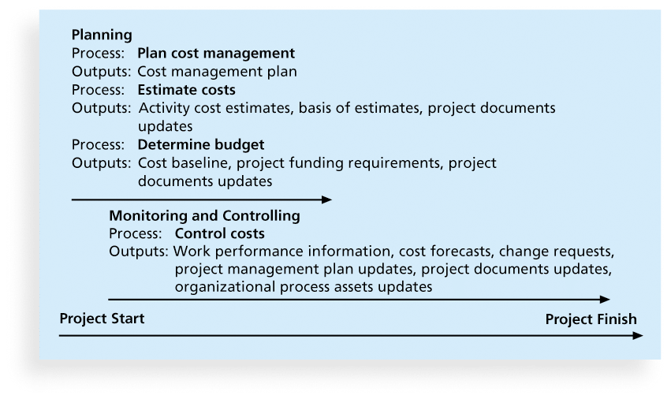
Figure 7-1.Project Cost Management Summary

Slide 6
Basic Principles of Cost Management
Most members of an executive board better understand and are more interested in financial terms than IT terms , so IT project managers must speak their language
Profits are revenues minus expenditures
Profit margin is the ratio of revenues to profits
Life cycle costing considers the total cost of ownership, or development plus support costs, for a project
Cash flow analysis determines the estimated annual costs and benefits for a project and the resulting annual cash flow
Notes:
To increase profits, a company can increase revenues, decrease expenses, or try to do both

Slide 7
Types of Costs and Benefits
Tangible costs or benefits are those costs or benefits that an organization can easily measure in dollars
Intangible costs or benefits are costs or benefits that are difficult to measure in monetary terms
Direct costs are costs that can be directly related to producing the products and services of the project
Indirect costs are costs that are not directly related to the products or services of the project, but are indirectly related to performing the project
Sunk cost is money that has been spent in the past; when deciding what projects to invest in or continue, you should not include sunk costs
Notes:
For example, suppose the Surveyor Pro project described in the opening case included a preliminary feasibility study. If a company completed this study for $100,000, the tangible cost of the study is $100,000. If Juan s government estimated that it would have cost $150,000 to do the study itself, the tangible benefits of the study would be $50,000 if it assigned the people who would have done the study to other projects. Conversely, intangible costs or benefits are costs or benefits that are difficult to measure in monetary terms. Suppose Juan and a few other people, out of personal interest, spent some time using government-owned computers, books, and other resources to research areas related to the study. Although their hours and the government-owned materials were not billed to the project, they could be considered intangible costs. Intangible benefits for projects often include items like goodwill, prestige, and general statements of improved productivity that an organization cannot easily translate into dollar amounts. Because intangible costs and benefits are difficult to quantify, they are often harder to justify.

Slide 8
More Basic Principles of Cost Management
Learning curve theory states that when many items are produced repetitively, the unit cost of those items decreases in a regular pattern as more units are produced
It is used for predicting cost reductions, estimating future performance, and improving processes.
Reserves are dollars included in a cost estimate to mitigate cost risk by allowing for future situations that are difficult to predict
Contingency reserves allow for future situations that may be partially planned for (sometimes called known unknowns) and are included in the project cost baseline
Management reserves allow for future situations that are unpredictable (sometimes called unknown unknowns
Notes:
Learning curve theory, also known as the experience curve, is a concept that describes how the cost, time, and effort required to perform a task decrease as a person or organization gains experience and becomes more efficient at the task. The theory is based on the observation that as people repeat a task, they become more skilled and proficient, leading to improvements in productivity and a reduction in the resources needed to complete the task.

Slide 9
Planning Cost Management
The project team uses expert judgment, analytical techniques, and meetings to develop the cost management plan
A cost management plan includes:
Level of accuracy and units of measure
Organizational procedure links
Control thresholds
Rules of performance measurement
Reporting formats
Process descriptions

Slide 10
Estimating Costs
Project managers must take cost estimates seriously if they want to complete projects within budget constraints
It’s important to know the types of cost estimates, how to prepare cost estimates, and typical problems associated with IT cost estimates

Slide 11
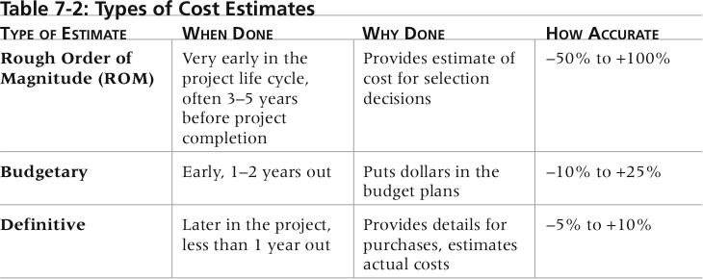
Table 7-2. Types of Cost Estimates
Notes:
provides an estimate of what a project will cost. ROM estimates can also be referred to as a ballpark estimate, a guesstimate, a swag, or a broad gauge. This type of estimate is done very early in a project or even before a project is officially started. Project managers and top management use this estimate to help make project selection decisions. The timeframe for this type of estimate is often three or more years prior to project completion. A ROM estimate s accuracy is typically 50 percent to 100 percent, meaning the project s actual costs could be 50 percent below the ROM estimate or 100 percent above. For example, the actual cost for a project with a ROM estimate of $100,000 could range between $50,000 to $200,000. For information technology project estimates, this accuracy range is often much wider. Many information technology professionals automatically double estimates for software development because of the history of cost overruns on information technology projects. A budgetary estimate is used to allocate money into an organization s budget. Many organizations develop budgets at least two years into the future. Budgetary estimates are made one to two years prior to project completion. The accuracy of budgetary estimates is typically 10 percent to 25 percent, meaning the actual costs could be 10 percent less or 25 percent more than the budgetary estimate. For example, the actual cost for a project with a budgetary estimate of $100,000 could range between $90,000 to $125,000. A definitive estimate provides an accurate estimate of project costs. Definitive estimates are used for making many purchasing decisions for which accurate estimates are required and for estimating final project costs. For example, if a project involves purchasing 1,000 personal computers from an outside supplier in the next three months, a definitive estimate would be required to aid in evaluating supplier proposals and allocating the funds to pay the chosen supplier. Definitive estimates are made one year or less prior to project completion. A definitive estimate should be the most accurate of the three types of estimates. The accuracy of this type of estimate is normally 5 percent to 10 percent, meaning the actual costs could be 5 percent less or 10 percent more than the definitive estimate. For example, the actual cost for a project with a definitive estimate of $100,000 could range between $95,000 to $110,000. Table 7-2 summarizes the three basic types of cost estimates.

Slide 12
Example Table 7-2
A ROM estimate s accuracy is typically -50 percent to +100 percent, meaning the project s actual costs could be 50 percent below the ROM estimate or 100 percent above. For example, the actual cost for a project with a ROM estimate of $100,000 could range between $50,000 to $200,000.
Notes:
provides an estimate of what a project will cost. ROM estimates can also be referred to as a ballpark estimate, a guesstimate, a swag, or a broad gauge. This type of estimate is done very early in a project or even before a project is officially started. Project managers and top management use this estimate to help make project selection decisions. The timeframe for this type of estimate is often three or more years prior to project completion. A ROM estimate s accuracy is typically 50 percent to 100 percent, meaning the project s actual costs could be 50 percent below the ROM estimate or 100 percent above. For example, the actual cost for a project with a ROM estimate of $100,000 could range between $50,000 to $200,000. For information technology project estimates, this accuracy range is often much wider. Many information technology professionals automatically double estimates for software development because of the history of cost overruns on information technology projects. A budgetary estimate is used to allocate money into an organization s budget. Many organizations develop budgets at least two years into the future. Budgetary estimates are made one to two years prior to project completion. The accuracy of budgetary estimates is typically 10 percent to 25 percent, meaning the actual costs could be 10 percent less or 25 percent more than the budgetary estimate. For example, the actual cost for a project with a budgetary estimate of $100,000 could range between $90,000 to $125,000. A definitive estimate provides an accurate estimate of project costs. Definitive estimates are used for making many purchasing decisions for which accurate estimates are required and for estimating final project costs. For example, if a project involves purchasing 1,000 personal computers from an outside supplier in the next three months, a definitive estimate would be required to aid in evaluating supplier proposals and allocating the funds to pay the chosen supplier. Definitive estimates are made one year or less prior to project completion. A definitive estimate should be the most accurate of the three types of estimates. The accuracy of this type of estimate is normally 5 percent to 10 percent, meaning the actual costs could be 5 percent less or 10 percent more than the definitive estimate. For example, the actual cost for a project with a definitive estimate of $100,000 could range between $95,000 to $110,000. Table 7-2 summarizes the three basic types of cost estimates.

Slide 13
Example Table 7-2
The accuracy of budgetary estimates is typically -10 percent to +25 percent, meaning the actual costs could be 10 percent less or 25 percent more than the budgetary estimate.
For example, the actual cost for a project with a budgetary estimate of $100,000 could range between $90,000 to $125,000.
Notes:
provides an estimate of what a project will cost. ROM estimates can also be referred to as a ballpark estimate, a guesstimate, a swag, or a broad gauge. This type of estimate is done very early in a project or even before a project is officially started. Project managers and top management use this estimate to help make project selection decisions. The timeframe for this type of estimate is often three or more years prior to project completion. A ROM estimate s accuracy is typically 50 percent to 100 percent, meaning the project s actual costs could be 50 percent below the ROM estimate or 100 percent above. For example, the actual cost for a project with a ROM estimate of $100,000 could range between $50,000 to $200,000. For information technology project estimates, this accuracy range is often much wider. Many information technology professionals automatically double estimates for software development because of the history of cost overruns on information technology projects. A budgetary estimate is used to allocate money into an organization s budget. Many organizations develop budgets at least two years into the future. Budgetary estimates are made one to two years prior to project completion. The accuracy of budgetary estimates is typically 10 percent to 25 percent, meaning the actual costs could be 10 percent less or 25 percent more than the budgetary estimate. For example, the actual cost for a project with a budgetary estimate of $100,000 could range between $90,000 to $125,000. A definitive estimate provides an accurate estimate of project costs. Definitive estimates are used for making many purchasing decisions for which accurate estimates are required and for estimating final project costs. For example, if a project involves purchasing 1,000 personal computers from an outside supplier in the next three months, a definitive estimate would be required to aid in evaluating supplier proposals and allocating the funds to pay the chosen supplier. Definitive estimates are made one year or less prior to project completion. A definitive estimate should be the most accurate of the three types of estimates. The accuracy of this type of estimate is normally 5 percent to 10 percent, meaning the actual costs could be 5 percent less or 10 percent more than the definitive estimate. For example, the actual cost for a project with a definitive estimate of $100,000 could range between $95,000 to $110,000. Table 7-2 summarizes the three basic types of cost estimates.

Slide 14
Example Table 7-2
The accuracy of this type of estimate is normally -5 percent to +10 percent, meaning the actual costs could be 5 percent less or 10 percent more than the definitive estimate.
For example, the actual cost for a project with a definitive estimate of $100,000 could range between $95,000 to $110,000. Table 7-2 summarizes the three basic types of cost estimates.
Notes:
provides an estimate of what a project will cost. ROM estimates can also be referred to as a ballpark estimate, a guesstimate, a swag, or a broad gauge. This type of estimate is done very early in a project or even before a project is officially started. Project managers and top management use this estimate to help make project selection decisions. The timeframe for this type of estimate is often three or more years prior to project completion. A ROM estimate s accuracy is typically 50 percent to 100 percent, meaning the project s actual costs could be 50 percent below the ROM estimate or 100 percent above. For example, the actual cost for a project with a ROM estimate of $100,000 could range between $50,000 to $200,000. For information technology project estimates, this accuracy range is often much wider. Many information technology professionals automatically double estimates for software development because of the history of cost overruns on information technology projects. A budgetary estimate is used to allocate money into an organization s budget. Many organizations develop budgets at least two years into the future. Budgetary estimates are made one to two years prior to project completion. The accuracy of budgetary estimates is typically 10 percent to 25 percent, meaning the actual costs could be 10 percent less or 25 percent more than the budgetary estimate. For example, the actual cost for a project with a budgetary estimate of $100,000 could range between $90,000 to $125,000. A definitive estimate provides an accurate estimate of project costs. Definitive estimates are used for making many purchasing decisions for which accurate estimates are required and for estimating final project costs. For example, if a project involves purchasing 1,000 personal computers from an outside supplier in the next three months, a definitive estimate would be required to aid in evaluating supplier proposals and allocating the funds to pay the chosen supplier. Definitive estimates are made one year or less prior to project completion. A definitive estimate should be the most accurate of the three types of estimates. The accuracy of this type of estimate is normally 5 percent to 10 percent, meaning the actual costs could be 5 percent less or 10 percent more than the definitive estimate. For example, the actual cost for a project with a definitive estimate of $100,000 could range between $95,000 to $110,000. Table 7-2 summarizes the three basic types of cost estimates.

Slide 15
More on Cost Estimates
The number and type of cost estimates vary by application area. The Association for the Advancement of Cost Engineering International identifies five types of cost estimates for construction projects: order of magnitude, conceptual, preliminary, definitive, and control
Estimates are usually done at various stages of a project and should become more accurate as time progresses
A large percentage of total project costs are often labor costs

Slide 16
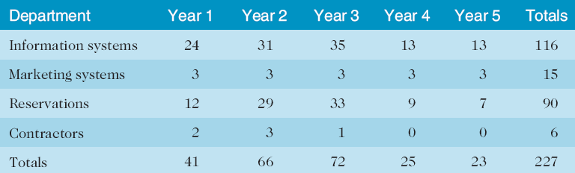
Table 7-3. Maximum FTE by Department by Year

Slide 17
Cost Estimation Tools and Techniques(1)
Basic tools and techniques for cost estimates:
Analogous or top-down estimates: use the actual cost of a previous, similar project as the basis for estimating the cost of the current project
For example, estimators often try to find a similar project and then customize/modify it for known differences. However, if the project to be estimated involves a new programming language or working with a new type of hardware or network, the analogous estimate technique could easily result in too low an estimate.
Notes:
Analogous estimating, also known as top-down estimating, is a project estimation technique that relies on historical data and expert judgment to predict the cost, effort, and duration of a new project. This method involves comparing the current project with similar past projects to derive estimates for the new project. Analogous estimating is typically used in the early stages of a project when detailed information is not yet available.

Slide 18
Cost Estimation Tools and Techniques(2)
Bottom-up estimates: involve estimating individual work items or activities and summing them to get a project total
Parametric modeling uses project characteristics (parameters) in a mathematical model to estimate project costs
Notes:
Bottom-up estimating is a project estimation technique that involves breaking down a project into smaller, more manageable tasks or work packages and estimating the cost, effort, and duration for each task individually. Once all tasks have been estimated, the estimates are aggregated to determine the overall project cost, effort, and schedule. Bottom-up estimating is typically used in the planning stage of a project when detailed information about tasks and resources is available.
In summary, bottom-up estimating is a valuable technique for generating detailed and accurate project estimates when sufficient information is available. However, it can be time-consuming and resource-intensive, making it less suitable for early-stage project estimation.

Slide 19
Cont’d
A parametric model might provide an estimate of $50 per line of code called KLCO(Kilo Lines of Code) for a software development project based on the programming language the project is using, the level of expertise of the programmers, the size and complexity of the data involved, and so on.
Parametric models are most reliable when the historical information that was used to create the model is accurate, the parameters are readily quantifiable, and the model is flexible in terms of the size of the project.
Notes:
Parametric modeling is a project estimation technique that uses mathematical models and historical data to predict the cost, effort, and duration of a project based on its key parameters or attributes. In this method, relationships between project variables are established using statistical techniques, such as regression analysis or learning curves. These relationships are then used to create equations or algorithms that can generate estimates for new projects based on their specific parameters.
Parametric modeling is used across various industries, including software development, construction, and manufacturing, and is particularly useful for projects with well-defined and quantifiable attributes.
In summary, parametric modeling is a valuable estimation technique for projects with well-defined and quantifiable attributes. It can produce accurate and time-efficient estimates when based on reliable historical data and well-developed models. However, its applicability may be limited for projects with unique or poorly defined characteristics, and it may require specialized skills and tools for model development.

Slide 20
Cont’d
Parametric models that are more complicated are usually computerized.
See the Suggested Readings on the companion Web site for examples of parametric models, such as the COCOMO (Constructive Cost Model) model.
The COCOMO (Constructive Cost Model) is a software cost estimation model developed by Dr. Barry Boehm. It helps predict the effort, cost, and schedule required for a software development project based on the size of the software and a set of cost drivers. The model has two main versions: COCOMO I (developed in 1981) and the more advanced COCOMO II (developed in the 1990s).
Notes:
KLOC (Kilo Lines of Code) is a software metric used to measure the size of a software program by counting the number of lines of source code in thousands. It is often used in various software estimation models, such as COCOMO (Constructive Cost Model), to predict the effort, cost, and schedule required for a software development project.

Slide 21
Cont’d
In practice, many people find that using a combination or hybrid approach involving analogous, bottom up, and/or parametric modeling provides the best cost estimates.
Notes:
KLOC (Kilo Lines of Code) is a software metric used to measure the size of a software program by counting the number of lines of source code in thousands. It is often used in various software estimation models, such as COCOMO (Constructive Cost Model), to predict the effort, cost, and schedule required for a software development project.

Slide 22
Typical Problems with IT Cost Estimates
Estimates are done too quickly
People lack estimating experience
Human beings are biased toward underestimation
Management desires accuracy
Notes:
Management's desire for accuracy is understandable, as accurate information is crucial for effective decision-making and project success. Here are some ways to ensure accuracy in project management:

Slide 23
Sample Cost Estimate
See pages chapter-7 for a detailed example of creating a cost estimate for the Surveyor Pro project described in the opening case
Before creating an estimate, know what it will be used for, gather as much information as possible, and clarify the ground rules and assumptions for the estimate
If possible, estimate costs by major WBS categories
Create a cost model to make it easy to make changes to and document the estimate

Slide 24
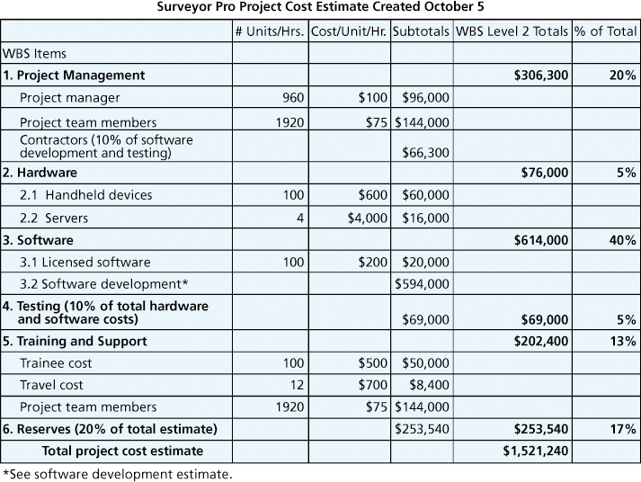
Figure 7-2. Surveyor Pro Project Cost Estimate

Slide 25
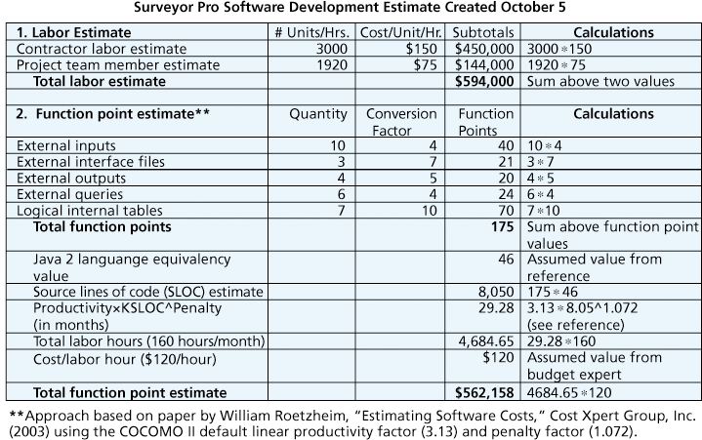
Figure 7-3. Surveyor Pro Software Development Estimate

Slide 26
Determining the Budget
Cost budgeting involves allocating the project cost estimate to individual work items over time
The WBS is a required input to the cost budgeting process since it defines the work items
Important goal is to produce a cost baseline
a time-phased budget that project managers use to measure and monitor cost performance

Slide 27
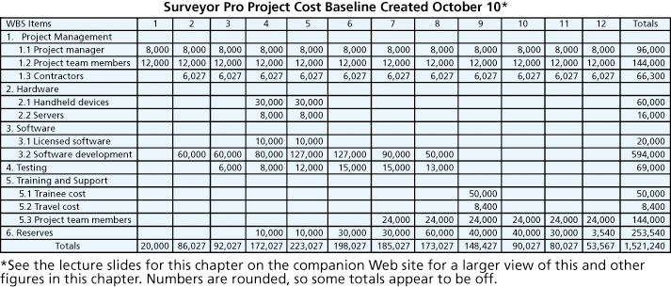
Figure 7-4. Surveyor Pro Project Cost Baseline

Slide 28
Controlling Costs
Project cost control includes
Monitoring cost performance
Ensuring that only appropriate project changes are included in a revised cost baseline
Informing project stakeholders of authorized changes to the project that will affect costs
Many organizations around the globe have problems with cost control

Slide 29
Earned Value Management (EVM)
EVM is a project performance measurement technique that integrates scope, time, and cost data
Given a baseline (original plan plus approved changes), you can determine how well the project is meeting its goals
You must enter actual information periodically to use EVM
More and more organizations around the world are using EVM to help control project costs

Slide 30
Earned Value Management Terms
The planned value (PV), formerly called the budgeted cost of work scheduled (BCWS)/budget, also called the budget, is that portion of the approved total cost estimate planned to be spent on an activity during a given period
Suppose a project included a summary activity of purchasing and installing a new Web server. Suppose further that, according to the plan, it would take one week and cost a total of $10,000 for the labor hours, hardware, and software involved. The planned value (PV) for that activity that week is, therefore, $10,000.

Slide 31
Cont’d
Actual cost (AC), formerly called actual cost of work performed (ACWP), is the total of direct and indirect costs incurred in accomplishing work on an activity during a given period
For example, suppose it actually took two weeks and cost $20,000 to purchase and install the new Web server. Assume that $15,000 of these actual costs were incurred during Week 1 and $5,000 was incurred during Week 2. These amounts are the actual cost (AC) for the activity each week.

Slide 32
Cont’d
The earned value (EV), formerly called the budgeted cost of work performed (BCWP), is an estimate of the value of the physical work actually completed
EV is based on the original planned costs for the project or activity and the rate at which the team is completing work on the project or activity to date

Slide 33
Rate of Performance
Rate of performance (RP) is the ratio of actual work completed to the percentage of work planned to have been completed at any given time during the life of the project or activity
Brenda Taylor, Senior Project Manager in South Africa, suggests this term and approach for estimating earned value
For example, suppose the server installation was halfway completed by the end of week 1. The rate of performance would be 50% because by the end of week 1, the planned schedule reflects that the task should be 100 percent complete and only 50 percent of that work has been completed

Slide 34
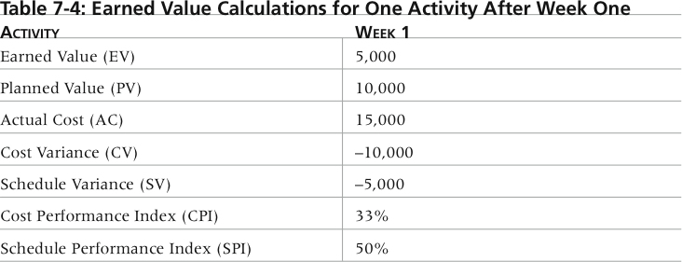
Table 7-4. Earned Value Calculations for One Activity After Week One

Slide 35
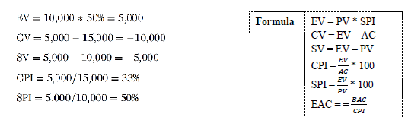
Cont’d

Slide 36
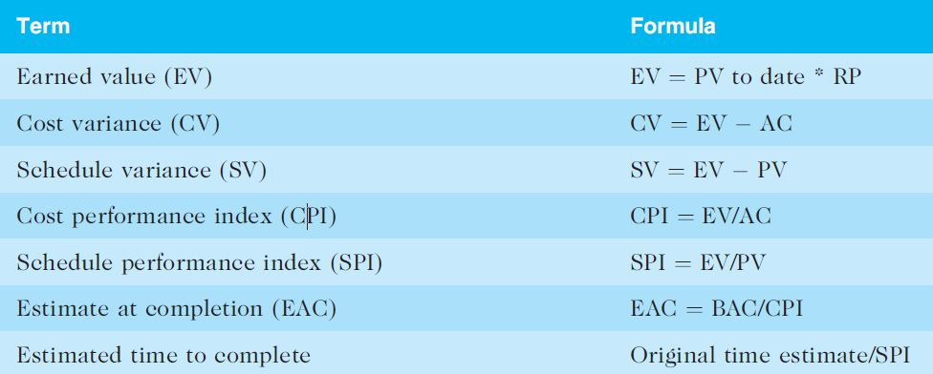
Table 7-5. Earned Value Formulas

Slide 37
Rules of Thumb for Earned Value Numbers
Negative numbers for cost and schedule variance indicate problems in those areas
CPI and SPI less than 100% indicate problems
Problems mean the project is costing more than planned (over budget) or taking longer than planned (behind schedule)
The CPI can be used to calculate the estimate at completion (EAC)—an estimate of what it will cost to complete the project based on performance to date. The budget at completion (BAC) is the original total budget for the project

Slide 38
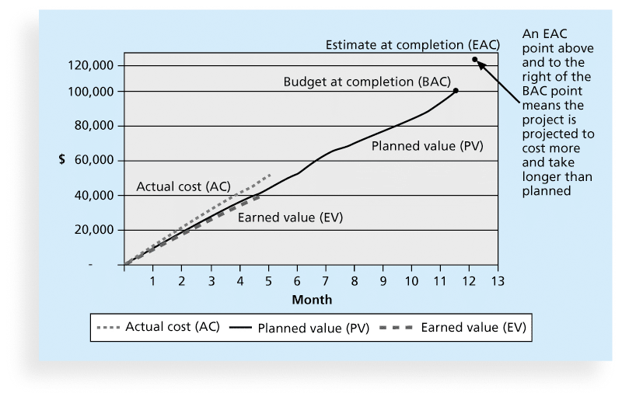
Figure 7-5. Earned Value Chart for Project after Five Months

Slide 39
Using Software to Assist in Cost Management
Spreadsheets are a common tool for resource planning, cost estimating, cost budgeting, and cost control
Many companies use more sophisticated and centralized financial applications software for cost information
Project management software has many cost-related features, especially enterprise PM software
Portfolio management software can help reduce costs

Slide 40
Chapter Summary
Project cost management is a traditionally weak area of IT projects, and project managers must work to improve their ability to deliver projects within approved budgets
Main processes include
Plan cost management
Estimate costs
Determine the budget
Control costs

Slide 41
End of chapter 4

